Slide 1


Introduction to Elasticsearch
Mr. Iyanou Eraste AKANDE Elastic Certified Engineer Data Engineer at Synaptique Maghreb

Slide 2

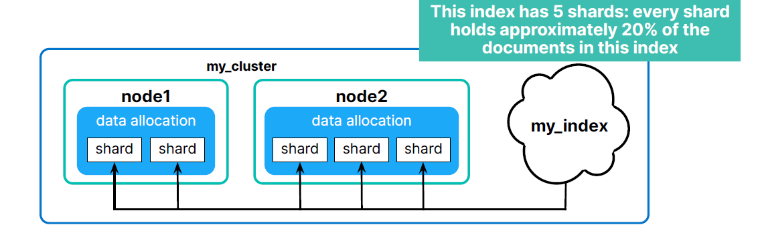
Architecture
Shards
Notes:
A shard is the smallest unit of an Elasticsearch Cluster

Slide 3
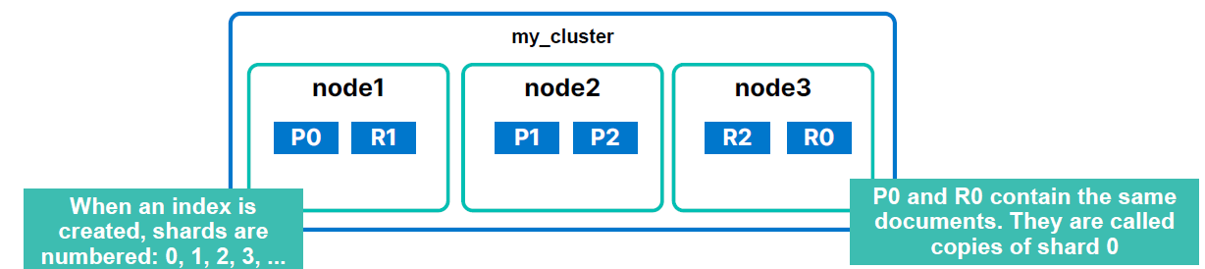
Architecture
Primary Vs Replica
Notes:
● There are two types of shards
○ primary shards: the original shards of an index
○ replica shards: copies of the primary shard
● Documents are replicated between a primary and its replicas
○ a primary and all replicas are guaranteed to be on different nodes
○ you can not increase the number of primary shards after an index is created
○ the number of replicas is dynamic
● High availability
○ you can lose a node and still have all the data
○ replicas are promoted to primaries as needed

Slide 4
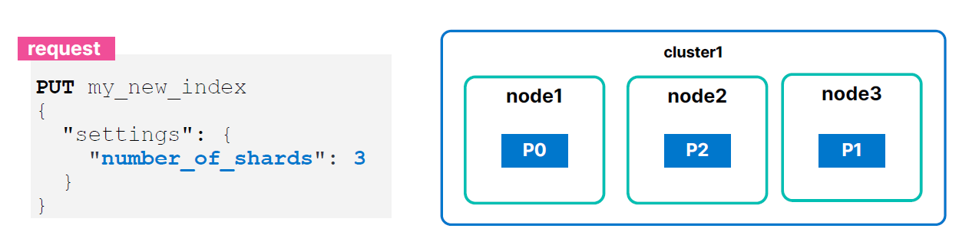
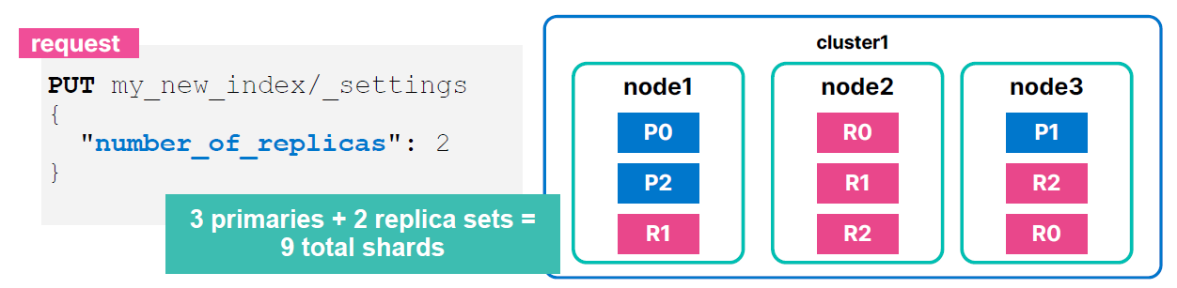
Architecture
Shards Configuration
Notes:
● Specify the number of primary shards when you create the index
○ default is 1
○ use the number_of_shards setting
● The default number of replicas per primary is 1
○ specify the number of replica sets when you create the index
○ use the number_of_replicas setting
○ can be changed at any time

Slide 5
Mapping
Default Mapping
“first_name” : text “first_name.keyword” : keyword
“name” : text
“name.keyword” : keyword
“gender” : text
“gender.keyword” : keyword
“city” : text “city.keyword” : keyword
“country” : text
“country.keyword” : keyword
“age” : long
“company” : text
“company.keyword” : keyword “starting_date” : text
“starting_date.keyword” : keyword
● Slow index speed
● Non optimized storage space
● Not improved searches
{
“first_name” : “Ali”,
“name” : “KOZNI”,
“gender” : “M”,
“city” : “Rabat”,
“country” : “Morocco”,
“age” : 25,
“company” : “INTEL”, “starting_date” : “2022-04-23”
}
Starting with Elasticsearch

Slide 6
Mapping
Explicit Mapping
PUT employees_data
{
"mappings": {
"properties": {
"first_name": {
"type": "keyword"
},
"age": {
"type": "integer"
}
"starting_date": {
"type": "date“,
“format”: “yyyy-MM-dd”
}
}
}
}
● Fast index speed
● Optimized storage space
● Improved searches
“first_name” : keyword “name” : keyword
“gender” : keyword
“city” : keyword “country” : keyword
“age” : integer
“company” : keyword “starting_date” : date
Starting with Elasticsearch

Slide 7
Mapping
Data Types
○ text: for full-text (analyzed) strings
○ keyword: for exact value strings and aggregations
○ date and date_nanos: string formatted as dates, or numeric dates
○ integer types: byte, short, integer, long
○ floating-point numbers: float, double, half_float
○ boolean
Starting with Elasticsearch

Slide 8
Mapping
Properties
● Mappings are Elasticsearch's data schema
● Mappings are defined per index
● If you do not define an explicit mapping, Elasticsearch will dynamically map the fields in your documents
● You cannot change the mapping of a field after the index has been created, but you can add new fields to a mapping
● Creating a custom mapping will produce savings in search and index speed, as well as memory and storage requirements
Starting with Elasticsearch

Slide 9
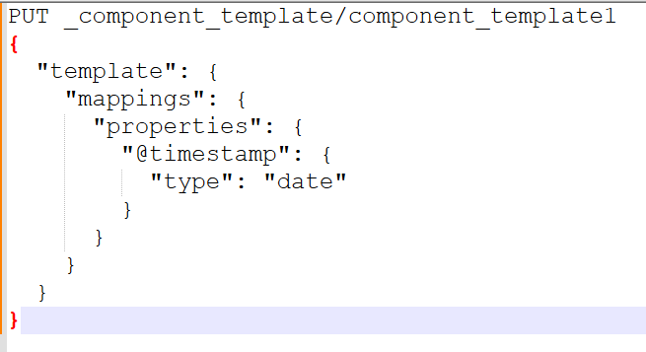
Component Template
● Reusable building blocks that can contain settings,
mappings or aliases
● Reused across multiple templates

Slide 10
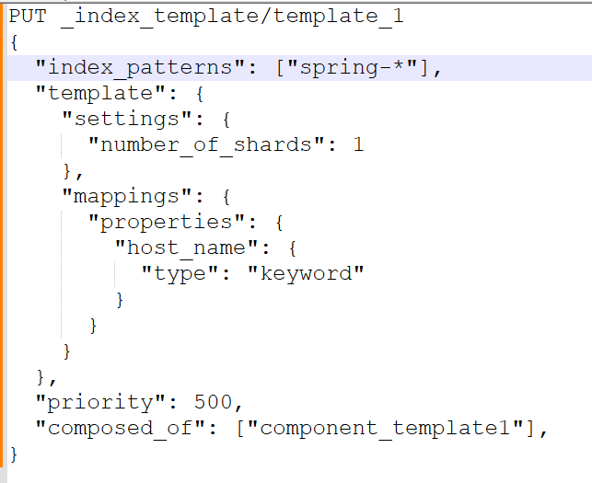
Index Template
● Multiple indices with the same settings and mappings
● Index template can contain
○ settings
○ mappings
○ aliases
○ component templates

Slide 11
Analysers
How to analyse text fields ?
Example: A quick brown fox jumps over the lazy dog
Built in Analysers
https://www.elastic.co/guide/en/elasticsearch/reference/current/analysis-analyzers.html
Character filters : Transform the stream by adding, removing, or changing characters (Ex: mapping, html_strip)
Tokenizers : Breaking a text down into smaller chunks (Ex: whitespace)
Token filters : A token filter receives the token stream and may add, remove, or change tokens (Ex: lowercase, stop, synonym)
Built in Tokenizers
https://www.elastic.co/guide/en/elasticsearch/reference/current/analysis-tokenizers.html
Built in Token filters
https://www.elastic.co/guide/en/elasticsearch/reference/current/analysis-tokenfilters.html

Slide 12
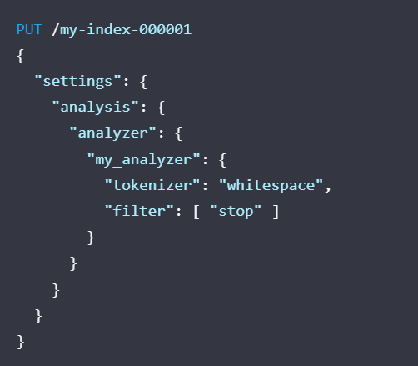
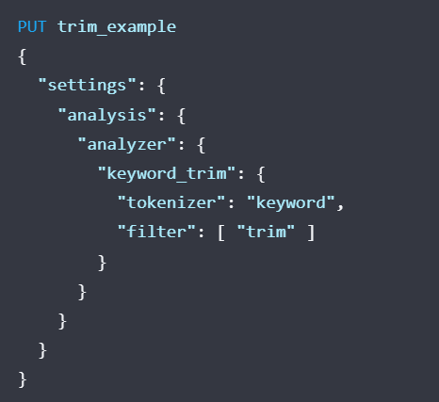
Analysers
Create a custom analyser

Slide 13
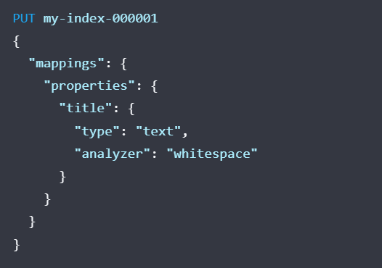
Analysers
Apply an analyser to a field

Slide 14
Query DSL
Search
GET index_name/_search
{
"query": {
"term": {
"name": "Alain"
}
}
}
GET index_name/_search
{
"query": {
"match": {
"title": "lifestyle"
}
}
}
https://www.elastic.co/guide/en/elasticsearch/reference/current/query-dsl.html

Slide 15
Query DSL
Aggregations
GET index_name/_search
{
"aggs": {
"my-agg-name": {
"terms": {
"field": "my-field"
}
}
}
}
GET index_name/_search
{
"aggs": {
"my-second-agg-name": {
"avg": {
"field": "my-other-field"
}
}
}
}
https://www.elastic.co/guide/en/elasticsearch/reference/current/search-aggregations.html

Slide 16
Reindex API
Local
POST _reindex
{
"source": {
"index": " source_index_name",
"query": {…}
},
"dest": {
"index": " destination_index_name"
}
}

Slide 17
Reindex API
Remote
POST _reindex
{
"source": {
"remote": {
"host": "http://otherhost:9200",
"username": "user",
"password": "pass"
},
"index": "remote_index",
},
"dest": {
"index": "local_index"
}
}

Slide 18
Update By Query
POST index_name/_update_by_query
{
"query": {
…..
},
"script": {
"source": "ctx._source. name = Ali"
}
}

Slide 19
Delete By Query
POST index_name/_delete_by_query
{
"query": {
"match": {
“name": “Malton Jack"
}
}
}

Slide 20
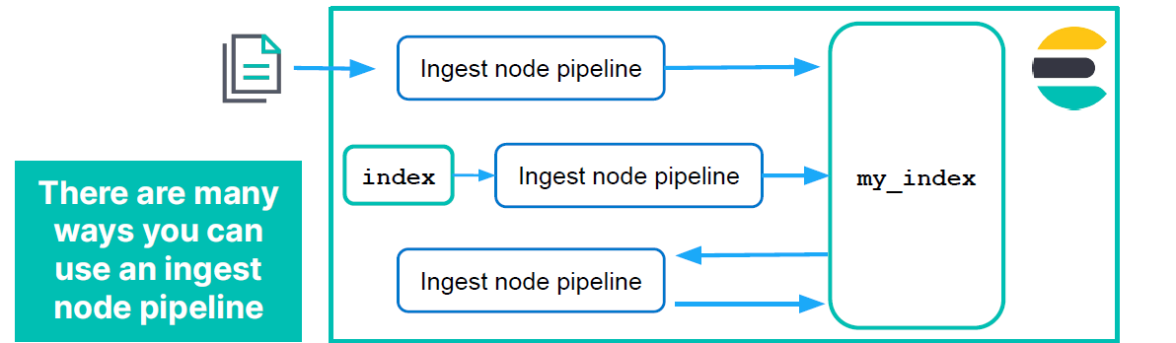
Ingest Node Pipelines
How it works ?

Slide 21
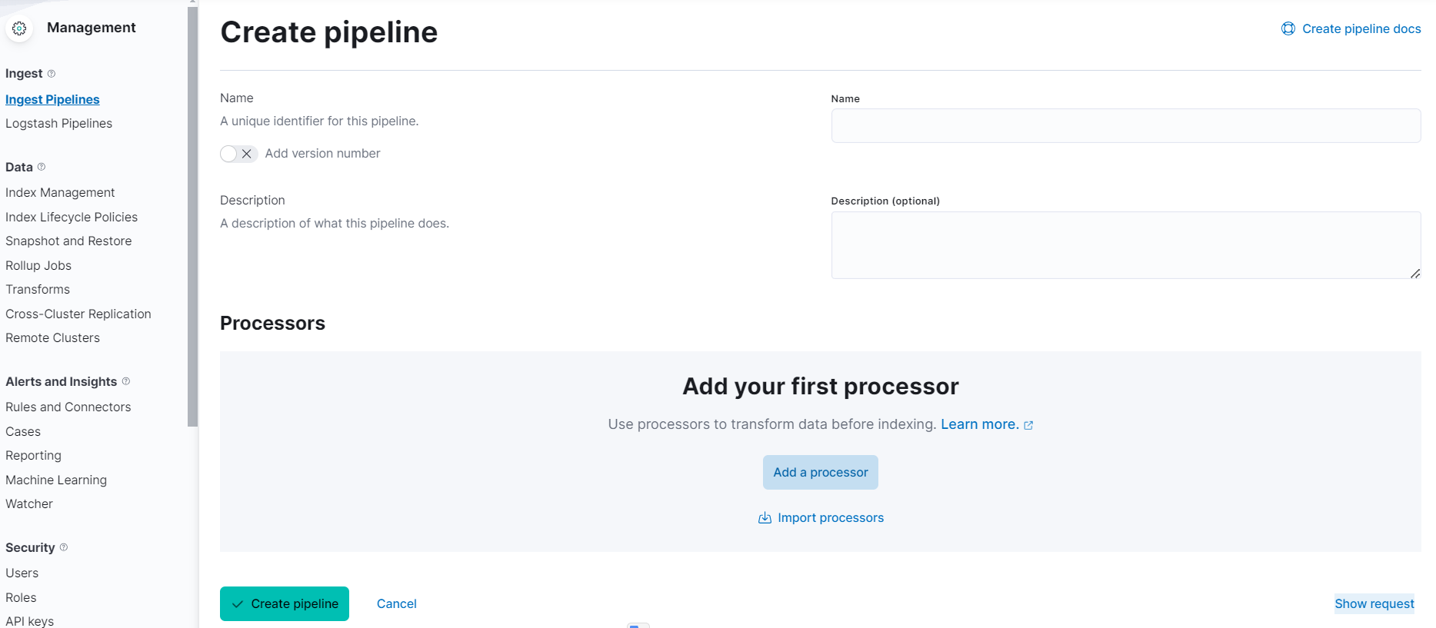
Ingest Node Pipelines
Pipeline Creation

Slide 22
Ingest Node Pipelines
Processors
Manipulate Fields
Manipulate Values
Special Operations
● split/join
● grok
● dissect
● gsub
● etc
● set
● remove
● rename
● dot_expander
● etc
● csv/json
● geoip
● user_agent
● script
● pipeline
● etc

Slide 23
Ingest Node Pipelines
Usage
POST my_index/_update_by_query? pipeline=my_pipeline
PUT my_index
{
"settings": {
"default_pipeline": "my_pipeline"
}
}
POST _reindex
{
"source": {
"index": "my_index"
},
"dest": {
"index": "new_index",
"pipeline": "my_pipeline"
}

Slide 24
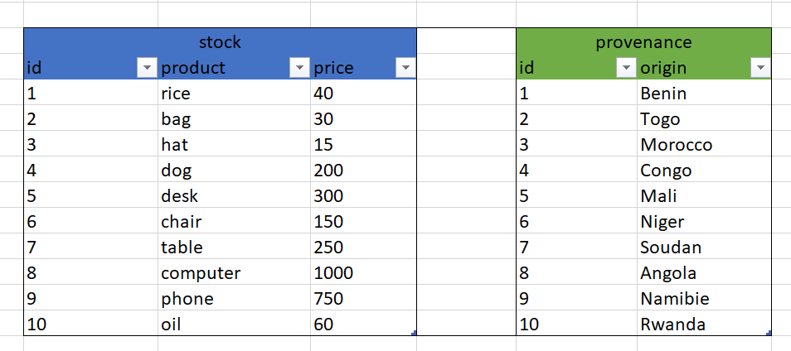
Enrich Data
Explanation

Slide 25
Enrich Data
Enrich Policy
PUT _enrich/policy/ product_mapper
{
"match": {
"indices": "provenance",
"match_field": "id",
"enrich_fields": ["country"]
}
}

Slide 26
Enrich Data
Create Enrich Index
POST _enrich/policy/product_mapper/_execute

Slide 27
Enrich Data
Ingest Pipeline
PUT /_ingest/pipeline/product_mapper_pipeline
{
"processors" : [
{
"enrich" : {
"policy_name": "product_mapper",
"field" : "id",
"target_field": "country"
}
}
]
}

Slide 28
Enrich Data
Use the pipeline
POST stock/_update_by_query?pipeline=product_mapper_pipeline

Slide 29
Transforms
Explanation
Group By
Aggregations
Source
Index
Destination
Index

Slide 30
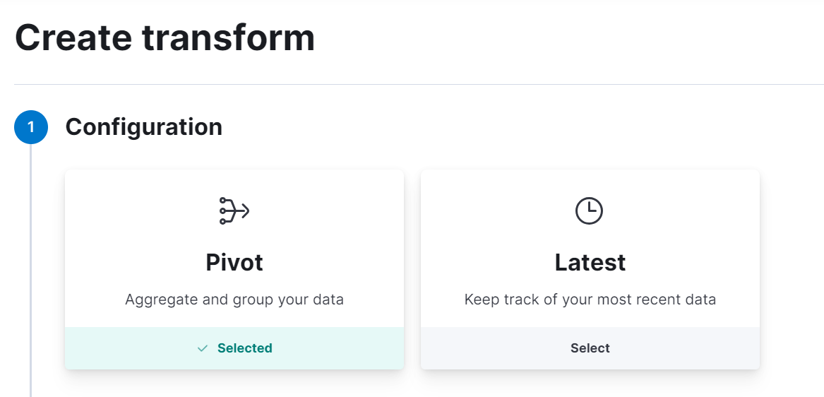
Transforms
Types
Notes:
○ Pivot collect results of complex bucket and metrics aggs
○ Latest collect most recent documents of bucket aggs

Slide 31
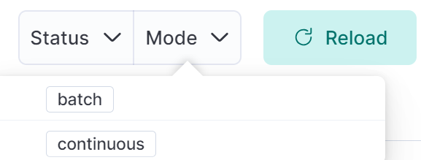
Transforms
Mode

Slide 32
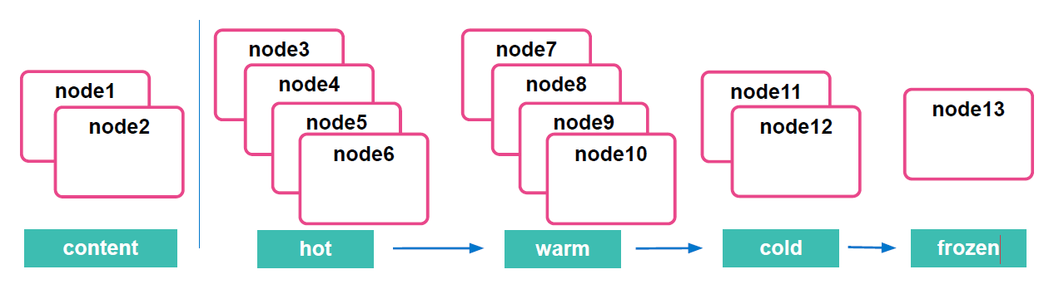
Index Lifecycle Management
Data Tiers
node.roles: ["data_warm", "data_content"]
Notes:
○ hot tier: have the fastest storage for writing data and for
frequent searching
○ warm tier: for read-only data that is searched less often
○ cold tier: for data that is searched sparingly
○ frozen tier: for data in searchable snapshots

Slide 33
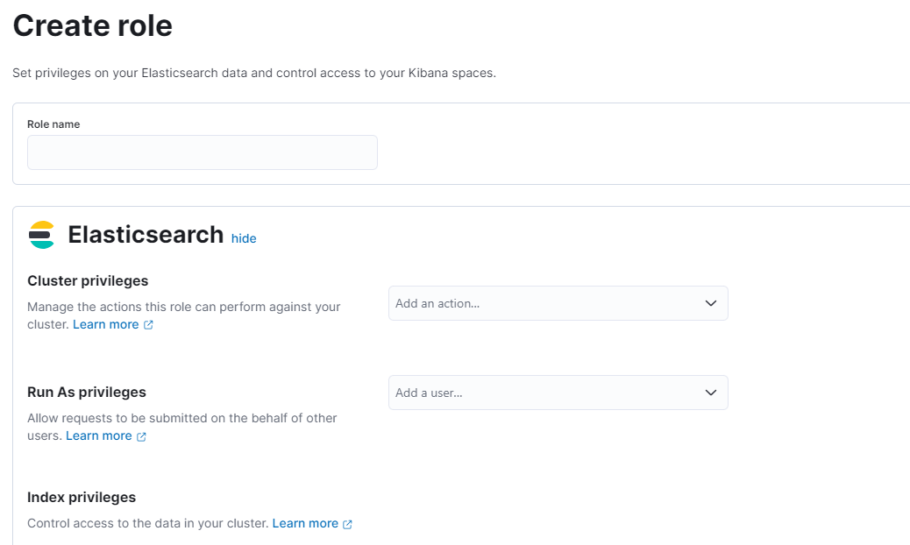
Security
Role

Slide 34
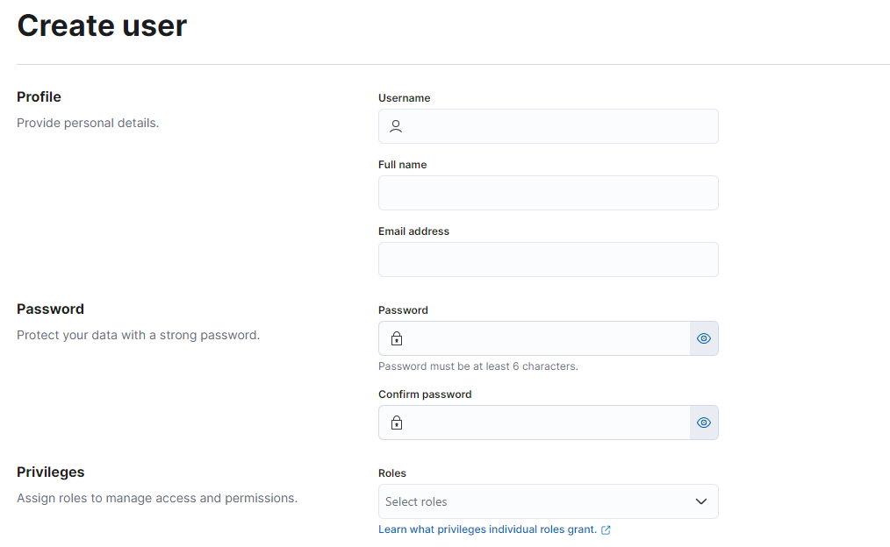
Security
User

Slide 35
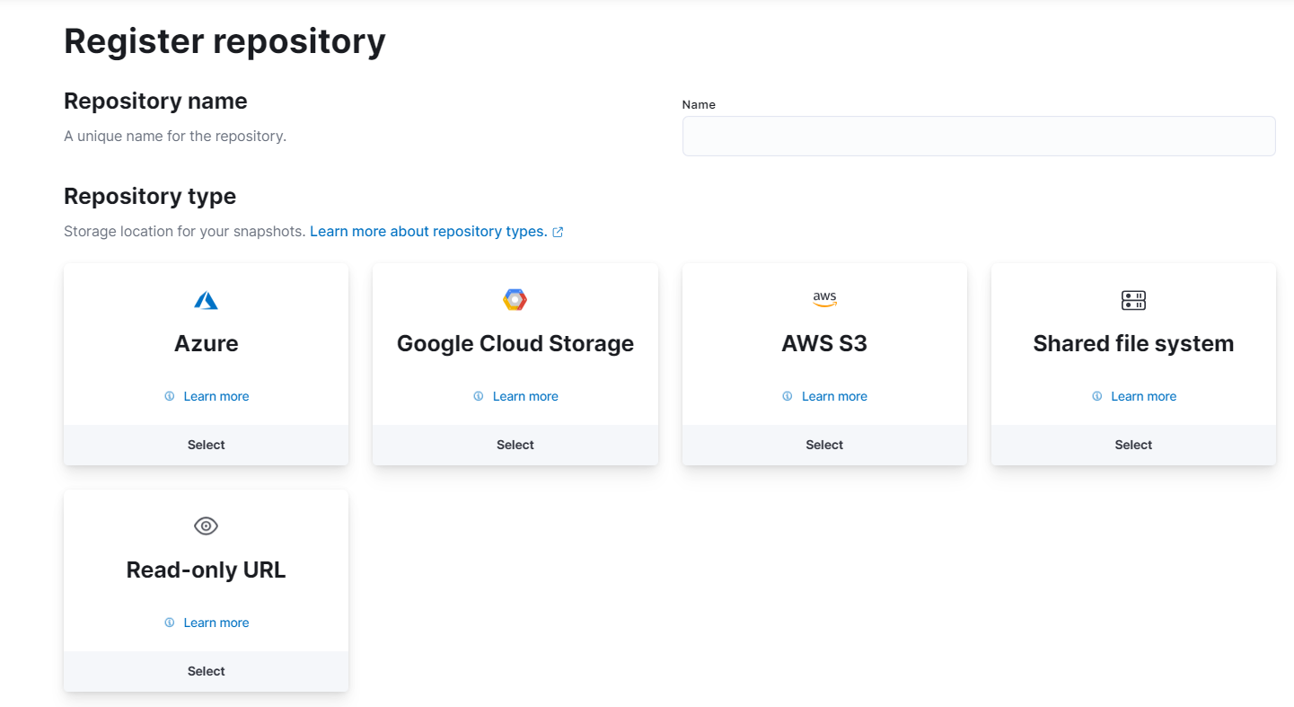
Snapshots & Restore
Repository

Slide 36
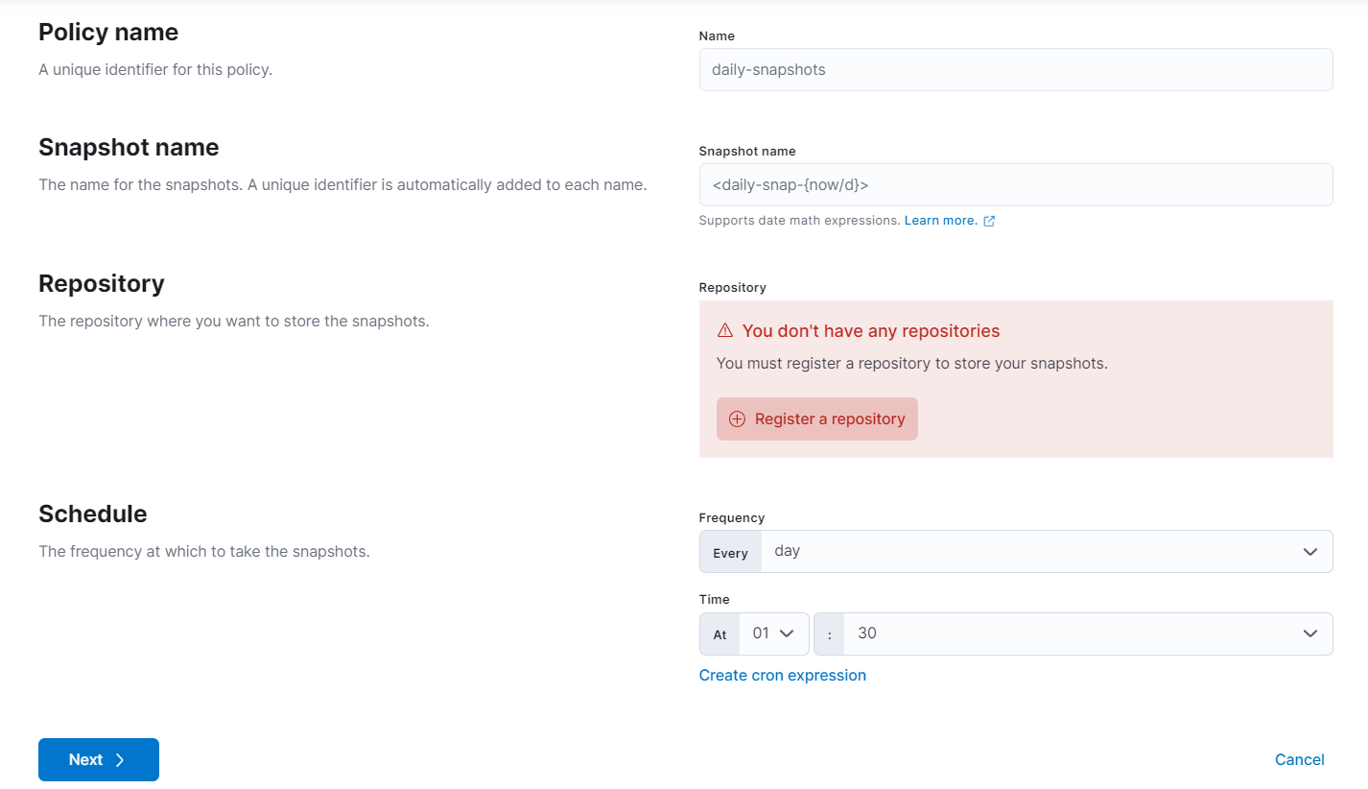
Snapshots & Restore
Policy

Slide 37
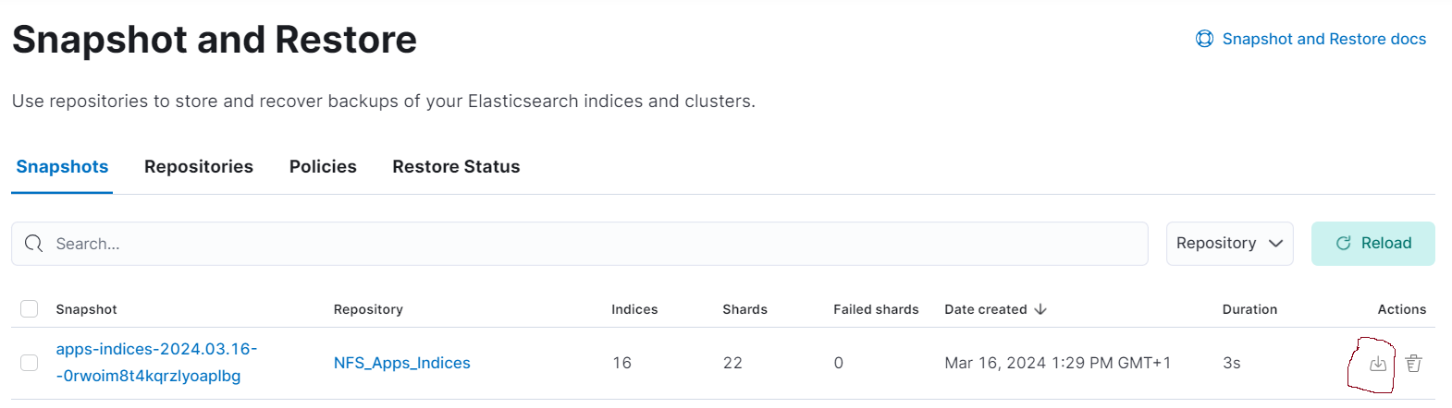
Snapshots & Restore
Restore

Slide 38
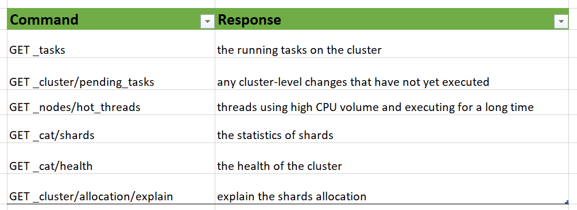
Troubleshooting

Slide 39
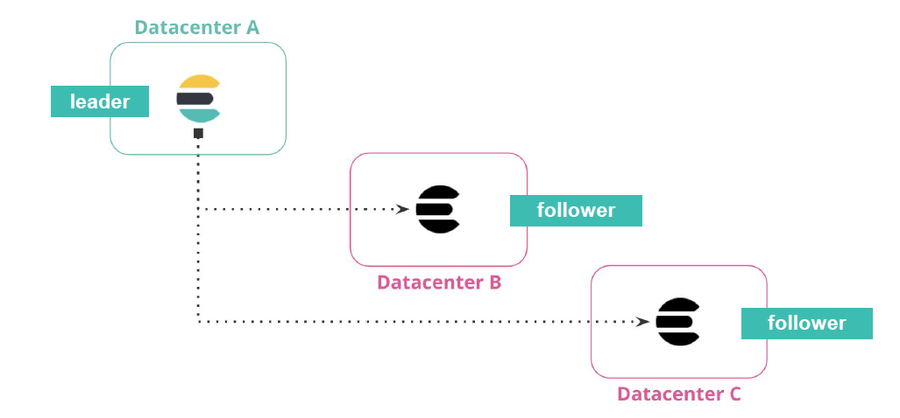
Cross Cluster Replication
Disaster recovery and high availability

Slide 40
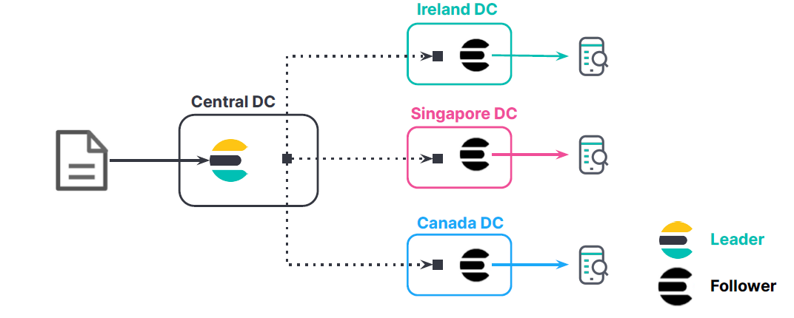
Cross Cluster Replication
Data locality

Slide 41
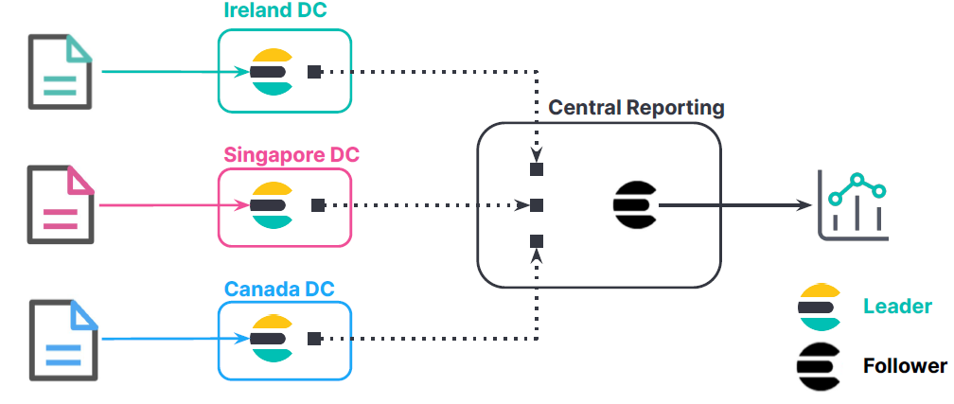
Cross Cluster Replication
Centralized reporting

Slide 42

Questions

Slide 43
Thank you
Mr. Iyanou Eraste AKANDE
eraste.akande@gmail.com

